Slide 1


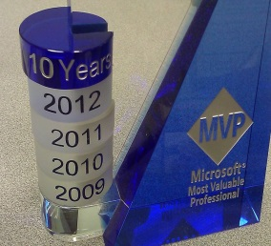



What do I need to know about SQL Server platform upgrade?
Manchester
SQLSaturday #418
Satya Jayanty
Satya Jayanty
sqlmaster@ sqlserver-qa.net
@SQLMASTER
www.sqlserver-qa.net

Slide 2

About me : Satya Jayanty
IT Experience
Been in the IT field over 24+ years (using SQL Server ver.4.2 onwards)
Principal Architect – D Bi A Solutions, Europe
10 years as Microsoft MVP (Windows – SQL Architecture)
Community Contributions
Speaker : Microsoft Tech-Ed (North America/India/Europe), SQLPASS, SQLSaturdays, SQL Bits, User Groups (Scottish Area SQL Server & Nottingham)
‘Ask The Experts’ Lounge: Microsoft Tech-Ed, HeroesHappnHere & SQLPASS
SME & Technical Reviewer for SQL Server 2008 & 2012 certification papers.
Publications
Founder (SQLMaster) & blogs at www.sqlserver-qa.net; (Knowledge Sharing Network)
Author: SQL Server 2008 R2 Administration cookbook & SQL Server Analysis Services 2012 Cube Security Instant
Co-Author: MVP Deep Dives Volume II. Technical Reviewer: SQL Server books from Packt Publishers.
Active participation in assorted forums such as SSP, SQL Server Central, MSDN, SQL Server magazine, dbforums etc.

Slide 3
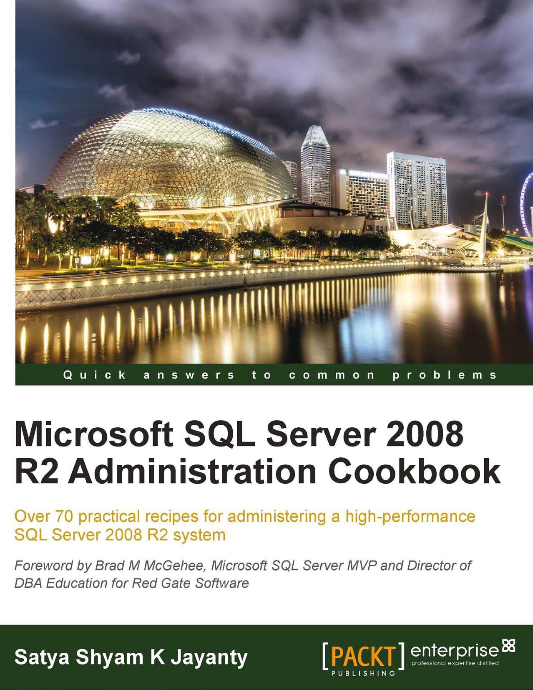
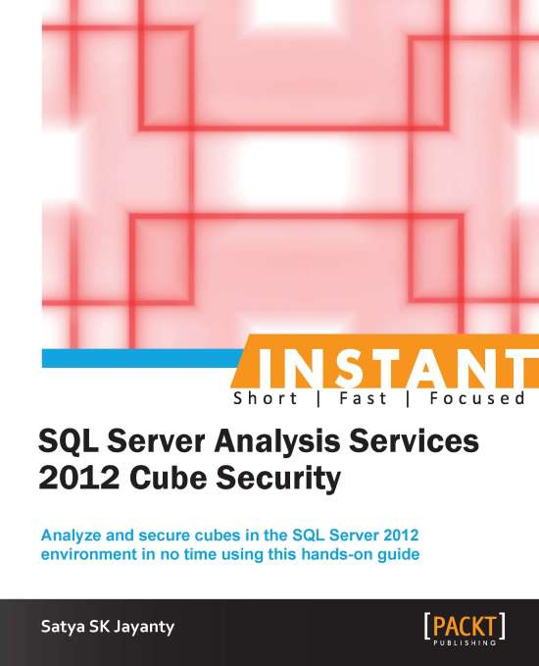
Author
http://tinyurl.com/sql2k8r2admincookbook
http://tinyurl.com/sql2012InstantCubeSecurity
eBook & PaperBack
www.packtpub.com
Amazon US & UK

Slide 4
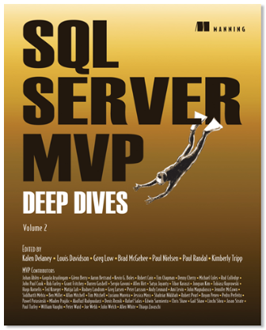

http://www.manning.com/delaney/
Manning Publications and the authors of this book support the children of Operation Smile.

Slide 5
Before We Begin
Covered
Why Upgrade?
Upgrade strategies
Upgrade scenarios
Lessons learned and recommended practices
Not Covered
End-to-end coverage or in-depth drilldown of all SQL Server features (2008 R2 to 2014/2016)
Exhaustive list of all issues, no magic tricks
Assumption
Working knowledge – SQL Server 2000 & above…. ☺
DBA/Developer/Architect/User/Geek
Notes:
Upgrade strategies - planning, options, methodology and tools
Upgrade scenarios – Clustering, Mirroring and so on
Lessons learned and recommended practices
List of important issues & upgrade tricks

Slide 6
…journey so far: SQL Server 2008 R2 to 2016 (CTP)
AlwaysOn
Online Operation Enhancements
Contained Database Authentication
Multi-site Clustering
Reliable Secondaries
SQL Server Express LocalDB
Windows Server Core Support
Statistical Semantic Search
PHP & Java Connectivity
FileTable
xVelocity
Unstructured Data Performance
Extended Events Enhancements
Multiple Secondaries
AlwaysOn Connection Director
PowerShell 2.0 Support
Database Recovery Advisor
Reporting Alerts
SQL Server Data Tools
PowerPivot Enhancements
Audit Filtering
T-SQL Debugger Enhancements
Resource Governor Enhancements
Full Globe Spatial
Power View
Flexible Failover Policy
Unstructured Data Performance
BI Semantic Model
Audit Resilience
CDC Support for SSIS
New SSIS Design Surface
Distributed Replay
User-defined Audit
Data Quality Services
SSMS to Windows Azure Platform
FTS Support for Czech and Greek
Master Data Management Excel Add-in
15k Partitions
Full-Text Search Performance
HA for StreamInsight
SSIS Troubleshooting
Availability Groups
Ad Hoc Reporting
Default Scheme for Windows Groups
Spatial 2D Support
ODBC Driver for Linux
SharePoint Active Directory Support
Polybase
T-SQL Enhancements
SSIS Package Management
SQL Audit for All Editions
Support for ‘R’
JSON Support
Stretch Databases
Query Store
Row Level Security
Always Encrypted

Slide 7





Déjà vu…
…
…
…
…
How can you perform upgrade (pro-actively)?
What tools can help collect data for analysis?
What kind of upgrade strategy you would follow on various SQL instances?
How can you detect troubled instances/databases?

Slide 8
The List….
Why Upgrade?
Building plan(s) & strateg(ies)…
Upgrade Route….
Tricks of the trade…..
Best Practices……
Round-up

Slide 9
Why Upgrade?
End of mainstream support
SQL Server 2000
SQL Server 2005
SQL Server 2008 & R2 …….(soon)
Hardware upgrade
Consolidation
….and
Notes:
If you are comfortable with current solution – stay with it
AlwaysOn – use secondaries for reporting, backups, loading datawarehouse and other activities

Slide 10
Mainstream and Extended support
Version | Mainstream | Extended
SQL Server 2000 SP4 | 08-04-2008 | 09-04-2013
SQL Server 2005 SP4 | 12-04-2011 | 12-04-2016
SQL Server 2008 SP4 | 08-04-2014 | 09-07-2019
SQL Server 2008 R2 SP3 | 08-04-2014 | 09-07-2019
SQL Server 2012 SP2 | 11-07-2017 | 12-07-2022
SQL Server 2014 SP1 | 09-07-2019 | 09-07-2024
https://support.microsoft.com/en-us/lifecycle

Slide 11
Why Upgrade?
New features
AlwaysOn Availability Groups
Windows Server Core Support
Columnstore Indexes
User-Defined Server Roles
Enhanced Auditing Features
BI Semantic Model
Sequence Objects
Enhanced PowerShell Support
Distributed Replay
PowerView
SQL Azure Enhancements
Big Data Support
Power BI for Office 365 integration
Always Encrypted
Stretch Database
Real-time Operational Analytics
PolyBase into SQL Server
Native JSON support
Always-On enhancements
Enhanced In-memory OLTP
Revamped SSDT
SSDT for BI
Updatable Columnstore Indexes
Backup Enhancements
Enhanced AlwaysOn Availability groups
Enhanced Windows 2012 Integration
Improved In-memory engine
2012
2014
2016 (CTP)
Notes:
2012
https://technet.microsoft.com/en-us/library/bb500435(v=sql.110).aspx
2014
https://technet.microsoft.com/en-us/library/bb500435(v=sql.120).aspx
2016
https://technet.microsoft.com/en-us/library/bb500435(v=sql.130).aspx (subject to change when RTM’d)

Slide 12
Upgrade life-cycle?
Checklist
Strategy
Tools
Environment
Product Features
Completion

Slide 13
What to choose ?
Components
Editions
Partial upgrade
Upgrading over time
Effect on application
Availability
Rollback
Notes:
Components: SSIS, SSAS, Engine itself
Editions: like Enterprise to Standard edition
Partial upgrade: move only few databases and leave the rest on the legacy version
Upgrading over time: To transition database graually
Effect on application: if your organization requires minimal disturbance to the existing app and user, choose wisely
Availability: both in-place and side-by-side requires that db be unavailable for some time
Rollback: for many db systems in production it is imposible to justify a change without a rollback strategy

Slide 14

The Ask
Boss says ready to upgrade…!!
Notes:
Thanks to @angelstreamline

Slide 15

Typical Answers
Aw damn.
I don’t know where to start?
Notes:
Thanks to @angelstreamline

Slide 16

Don’t let this happen to you
Notes:
Thanks to @angelstreamline

Slide 17
Look back…
Backward compatibility
Deprecated Features
Discontinued Features
Breaking Changes
Behavior Changes
Notes:
These features are scheduled to be removed in a future release of SQL Server. Deprecated features should not be used in new applications.
Eg. Compatibility level 90 in 2014
These changes might break applications, scripts, or functionalities that are based on earlier versions of SQL Server.
E.g. PIVOT inside CTE
ALTER TABLE needs to
New columns in DMVs or catalog views
New collations
Xquery datetime support - in 2005 default time zone of UTC is mapped in 2008+
Trace flag changes
Behavior changes affect how features work or interact in SQL Server 2014 as compared to earlier versions of SQL Server.
E.g. new options to page verify
Scripting sql agent job
Length of xml string (more than 4020 chars)

Slide 18
Planning
Preparing to Upgrade
Review upgrade documentation and resources
Document your resources and environment
Identify upgrade requirements
Decide on upgrade strategy
Upgrade High-Availability servers
Establish backup and rollback plans
Test the plan!!!
Notes:
SQL Sever editions/features
Hardware considerations
Application compatibility

Slide 19

Pre-Upgrade
Pre-Upgrade
Check environment
Run SQL Server Upgrade Advisor (2008 R2 SP3, 2012 SP1 & 2014)
Ensure environment is clean
Check database consistency
Consider shrink Data file (read-only DB) and log files
Rebuild indexes
Run SQL Server 2012/2008R2/2005/2000 Best Practices Analyzer (BPA)
Back up your environment
System and user databases including DTS/SSIS packages
…what else
Documentation

Slide 20
Prepare to Post-upgrade
The Upgrade
Document every step
System health checks
Perform the upgrade - strategy
Environment backup (pre to post)
Go/No-go (Checkpoint)
Review the logs
Troubleshoot - upgrade failure
Test functionality and performance.
Determine application acceptance

Slide 21
Upgrade Planning & Steps
Planning
Prepare
Testing
Pre-Upgrade
Checkpoint
Post-upgrade

Slide 22
Upgrade Strategy
Side-by-Side
In-Place
New Instance

Slide 23
In-Place Upgrade
Upgrades an existing installation
Instance name remains the same after upgrade
Old instance no longer exists
User data and configuration is preserved
Mostly automated process through SQL Server Setup
Performed on same machine as existing installation
Pros & Cons.
Automated, Faster & Less effort
No Application Changes
All DBs upgrade
Complex Rollback Strategy

Slide 24
In-place upgrade
SQL Server 2005/
2008/2008R2/
2012 instance
SQL Server 2014/2016 instance

Slide 25
Side-by-Side (Migration) Upgrade
Install new instance of SQL Server without affecting existing instance
Can be same or different server
Database objects are manually copied to new instance
Copy Database Wizard/Detach -> Copy -> Attach/Backup -> Restore
Pros & Cons.
New platform altogether
More efforts to Upgrade
Connectivity Changes
Do-It-Yourself
Controlled Switchover
Easy Rollback Strategy

Slide 26
Side-by-side upgrade on the same server
SQL Server 2005/
2008/2008R2/
2012 instance (unchanged)
SQL Server 2005/
2008/2008R2/
2012 instance
New SQL Server 2014 instance

Slide 27
Side-by-side upgrade – new instance
Old instance of SQL Server remains unchanged
SQL Server 2005/
2008/2008R2/
2012 instance
New SQL Server 2014 instance

Slide 28
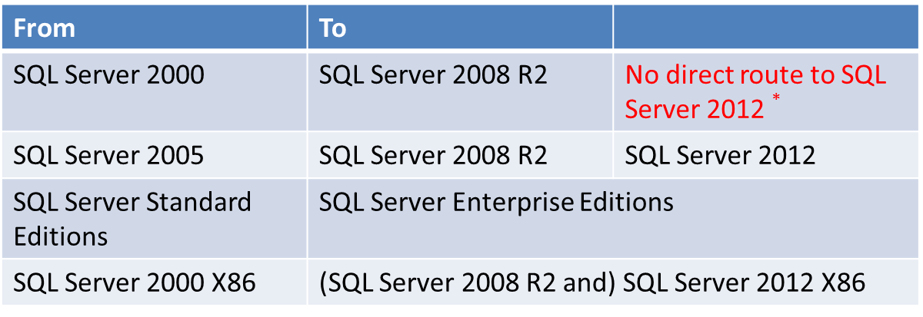
Allowable Upgrade Paths
Edition Upgrade: Can go up but cannot go down
See
http://msdn.microsoft.com/en-us/library/ms143393(v=sql.105).aspx - 2008 R2
http://msdn.microsoft.com/en-us/library/ms143393.aspx - 2012
* Upgrade SQL Server 2000 SP4 to SQL Server 2008 R2 and then upgrade to SQL 2012!

Slide 29
Possible version upgrade paths
SQL 2000 SP4
SQL 2014
SQL 2005 SP4
SQL 2008 SP3
SQL 2008R2 SP2
SQL 2012 SP1

Slide 30
Possible edition upgrade paths
SQL Server 2005 - 2012
Express
SQL Server 2014
Workgroup
Express
Web
Web
Small Business
Standard
Standard
Business Intelligence
Business Intelligence
Developer
Datacenter
Enterprise
Developer
Enterprise

Slide 31
Failover Cluster Upgrade – Overview
Rolling upgrade
Via SQL Server Installation Center
Install prerequisites on all nodes before upgrade
.NET Framework 3.5 SP1
Windows Installer 4.5
SQL Server setup support files
Windows Server 2003 SP2 – need hotfix for FileStream (KB 937444)
Fail over to an upgraded node.
Passive node → Active node!
Notes:
Changes since SQL Server 2008 - rolling upgrade with minimal downtime:: SQL Server Installation Center
Start with passive node and end with active node
Failover happens automatically
Start failover cluster upgrade process with passive nodes, making your way toward the active node

Slide 32
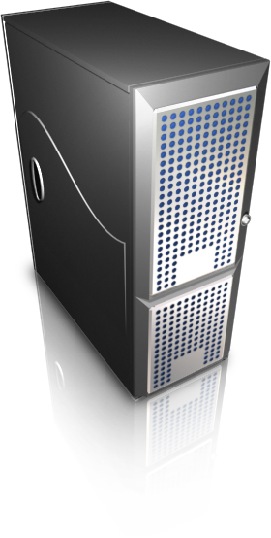

Sample scenario Initial configuration
Active
Passive
Storage
Windows Server EE SP2, 32-Bit or
Windows Server 2008 R2 EE SP2, 64-Bit
SQL Server 2000 EE SP4 64-Bit or
SQL Server 2005 EE SP4 32-BIT
Minimum Hardware & Software requirements:
http://msdn.microsoft.com/en-us/library/ms143506(v=sql.110).aspx
One big change to SQL Server 2012 is how it is licensed.

Slide 33
Sample scenario Installation of prerequisites
Step #2:
Install Prerequisites:
1- .Net Framework 3.5 SP1
2- Windows Installer 4.5
3- Windows QFE (KB937444) (WIN2003SP2)
4- SQL2008 R2 or 2012 Setup Support files
REBOOT …..
Step #1:
Install Prerequisites:
1- .Net Framework 3.5 SP1
2- Windows Installer 4.5
3- Windows QFE (KB937444) (WIN2003SP2)
4- SQL2008 R2 or 2012 Setup R2Support files
REBOOT….
Active
Passive
SQL Instance Manual Failover

Slide 34
Sample Scenario Upgrade clustered components
Step #3:
Upgrade to SQL Server 2008 R2 SP2 or 2012 SP1 on Passive Node
Step #4:
Upgrade to SQL Server 2008 R2 SP2 or 2012 SP1 on Active Node
SQL Server 2008 R2 SP2 or SQL Server 2012 SP1
No client connection for 1-2 minutes while db is being upgraded to 2008 on the left node
SQL Server 2008 R2 SP2 or SQL Server 2012 SP1
Removed from Cluster Group Possible Owners
Passive
Active
Active
Step 5: SQL Instance Automatic Failover

Slide 35
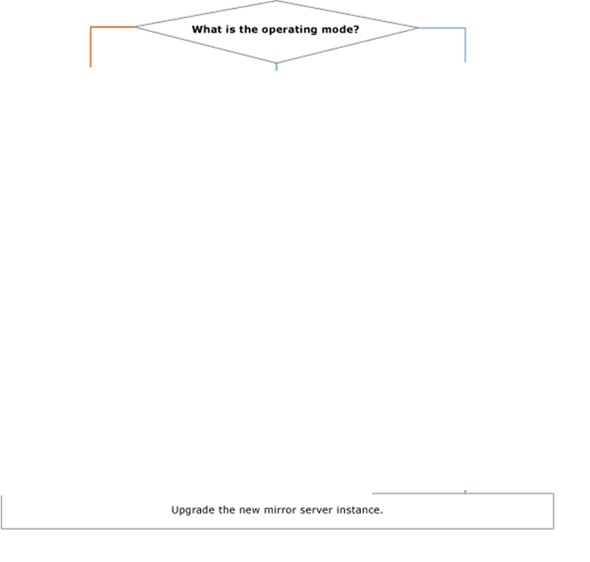
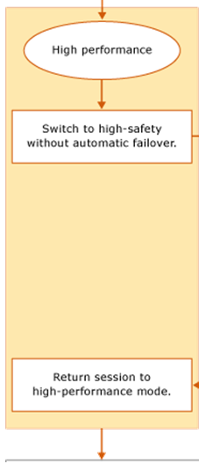
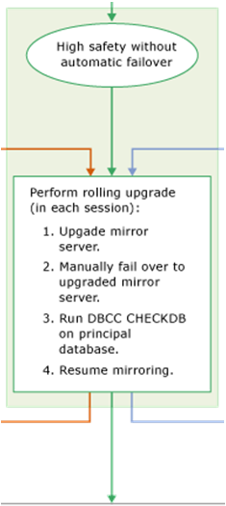
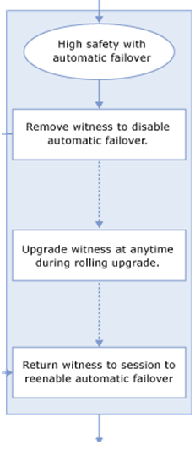
Database Mirroring - Upgrade Scenario
Rolling upgrades supported to minimize impact
Keep similar versions & SP - Mirror & Principal
At least one manual failover required
Typical upgrade flow

Slide 36
Additional Upgrade Scenarios Failover cluster with mirroring
Step#2: Manual Failover to the database mirroring partner for each database
Step #1:
Upgrade to SQL Server 2008 R2 or 2012/2014 on mirrored instance
Step#4: Manual Failover to the database mirroring partner for each database
SQL
Server 2008 R2/2012/2014
SQL 2008 R2or 2012/2014
Principal
Step #3:
Upgrade Cluster to SQL Server 2008 R2 or 2012/2014
Mirrored SQL
SQL Server Cluster
Mirroring suspended
Mirroring resumed
Active
Passive
36

Slide 37
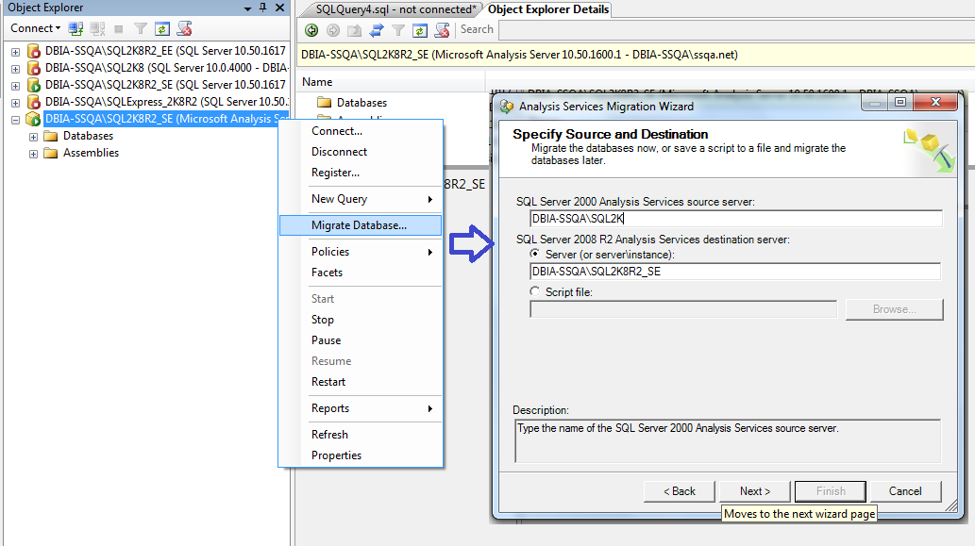
Upgrading Analysis Services
Upgrade 2005 to 2008 – Either an in-place or side-by-side upgrade
Analysis Services Migration Wizard is recommended
Install a new SSAS Tabular Model instance
SSAS2012 Upgrade only to Multi-dimensional instance
Notes:
SSAS has been significantly upgraded in SQL Server 2012. SQL Server 2012 added the tabular model and introduced the Business Intelligence Semantic Model (BISM). One choice that must be made when performing an upgrade is whether to continue using the multidimensional model or to switch to the tabular model. You cannot specifically upgrade a multidimensional instance to tabular mode, but you can install a new instance of SSAS that supports tabular model solutions and run both instances side by side. In other words, you can upgrade an instance of the multidimensional instance, or you can add a new instance of the tabular model. Since the tabular model did not exist in previous versions of SQL Server, there is no upgrade for it. For more information, see Install Analysis Services in Tabular Mode (http://msdn.microsoft.com/en-us/library/hh231722(v=sql.110).aspx).

Slide 38
Upgrading Reporting Services (RS)
Database engine and Reporting Services components
RS components can be upgraded without database engine
RS DB schema will be updated
Upgrade support to SQL Server 2012:
SQL Server 2005 Reporting Services SP4.
SQL Server 2008 Reporting Services SP2.
SQL Server 2008 R2 Reporting Services SP1.
Known upgrade issues:
SSRS 2012 - No support for earlier versions of the Reporting Services WMI provider.
In-place upgrade is not supported from one mode of Reporting Services server to another.
See http://msdn.microsoft.com/en-us/library/ms143747(v=sql.110).aspx
For example, you cannot upgrade a Native Mode report server to a SharePoint mode report server.
Notes:
After upgrade, you cannot use the SQL Server 2012 Reporting Services (SSRS) WMI provider with earlier versions of Reporting Services.

Slide 39
Upgrading DTS and/to SSIS
DTS is deprecated (2008 R2)
SQL Server 2005/2008 still includes DTS functionality, but SQL Server 2012 is not
DTS upgrade options:
Migration DTS packages to SSIS
DTS Migration Wizard (DTSMigrationWizard.exe)
3rd party tools available, such as www.dtsxchange.com
Continue to run DTS packages using the DTS runtime
No design/runtime support on 64-bit or 32-bit on IA64
Incorporate DTS package into SSIS packages
SSIS use the SSIS package upgrade Wizard

Slide 40
Big question?
How long it will take to upgrade?
No simple way to determine the factors…
…………….It Depends!
Real-time Scenario
3 customer cases are presented here….

Slide 41
Real-time Scenario & Solution….
Case 1:
Re-Insurance data warehouse (OLTP & OLAP)
Data sizes approx. 10 TB (35 databases)
Upgrade path: SQL Server 2005 to 2008 R2 EE (2012 soon)
6 + 1 weeks to complete
6 weeks of very-intensive preparation + 1 week focused on performance gains of the new platform & testing functionality.
Problems & Solutions
Database compression (sp_estimate_data_compression_savings) and Sparse columns features used (tested).
Query & Table hints used
Filtered statistics & partitioned tables feature after the upgrade.
SQLCAT article: Using Filtered Statistics with Partitioned Tables

Slide 42
Real-time Scenario & Solution….
Case 2:
Retail chain (highly OLTP) with Transactional Replication
Data sizes approx. 1.5 TB (8 databases)
Upgrade path: SQL Server 2000 to 2008 R2
3 months to complete (very intensive)
32-bit SQL Server 2000 Cluster with heavy use of transactional replication (110 subscribers, 67 articles)
Poor connectivity across subscribers caused upgrade without replication resynchronization.
Upgrade to the 64-bit version of SQL Server 2008 made an in-place upgrade impossible.
SQLCAT article: Upgrading Replication from SQL Server 2000 32-Bit to SQL Server 2008 64-Bit without re-initialization

Slide 43
Real-time Scenario & Solution….
Case 3:
Banking Sector (complex Biz logic)
OLTP (Clustering/DB Mirroing/SSRS & DTS)
Data sizes approx. 3 TB 25 databases)
Upgrade path: Mixture (Production to 2012 & Archive to 2008 R2)
2 months to complete (+2 weeks performance tuning)
Separate upgrade for 2000 databases and 2005 databases
DB mirroring instances to Availability Groups feature
Reporting Services upgrade, DTS migration – DTSXchange & SSIS migration
Problems & Solutions
Complex Biz logic: Spent time fighting execution plans that changed after migration (reads):
Used SET STATISTICS IO ON / SET STATISTICS PROFILE ON / SET STATISTICS TIME ON
Most cases SELECTS involving 6 or more joins – new indexes on post-upgrade
Use of Availability groups HA feature in SQL Server 2012

Slide 44
Tools
SQL Server 2014 Upgrade Advisor
Best Practices Analyzer for SQL Server
SQL Server 2014 Setup: System Configuration Checker
Upgrade Assistant for SQL Server 2012 (UAFS) plays together with Distributed Replay
RMLUtils
SQL Server Profiler/Extended Events
System Monitor – SQL Server: Deprecated Features Object
Custom scripts*
Notes:
Sp_WhoIsActive
Login_sync script
Ola Hallengreen maintenance scripts

Slide 45
Tricks of the Trade…. & tools.
Prepare for Upgrade – no data changes
Installed Services & Components analysis
Detailed report on why upgrade might fail.
Upgrade Tools
SQL Server Upgrade Advisor
SQL Server Upgrade Assistant
MAP Toolkit
Distributed Replay
RML Utilities
Best to setup to baseline (Pre & Post)
Testing workload
Ideal to solve compatibility issues
Best Discovery tool for Assessment & Reporting
Workload simulation Ideal for Performance testing & capacity planning
Ideal for platform Stress (ReadTrace & Ostress) testing.
Notes:
What is Distributed Replay?
Multi-client scalability to drive higher throughput
Higher workload replay fidelity
Useful for stress testing production workload or performing application compatibility testing before upgrades
Why an enhanced replay tool?
Address limitations of current SQL Trace based tools (Profiler, Upgrade Assistant)
Provide enhanced features
Groundwork for future workload testing capabilities

Slide 46
SQL Server Upgrade Advisor – 2008R2, 2012 & 2014
DBA Workbench – SQL Server 2016
Available from SQL Server Installation Center or Feature Pack (updated):
http://www.microsoft.com/en-sa/download/details.aspx?id=16978 - SQL Server 2008 R2 Upgrade Advisor
http://www.microsoft.com/en-us/download/details.aspx?id=29065 - SQL Server 2012 Upgrade Advisor
Same for 2014
Demo

Slide 47
SQL Server: Deprecated Feature Object
Captures application code that uses deprecated statements
Ideal in post-upgrade scenario to capture previous version’s code
Demo
Built-in Discovery Tool
Microsoft Assessment and Planning (MAP) Toolkit
Requires Word, Excel & individual SQLExpress installation
Available off of the Installation Center or download: http://technet.microsoft.com/en-us/solutionaccelerators/dd537566.aspx

Slide 48

Deprecated & Discontinued features
Code changes
Old style vs New style
Complex queries: more than five joins
check execution plan (estimated vs actual)
No room for code change:
Use Plan guides, Plan caching and Query hints (USE PLAN).
Storage optimization
disk partition alignment & pre-deployment I/O practices articles from SQLCAT blog.

Slide 49
Post-Upgrade tasks
Checklist
Determine application acceptance (end-to-end)
Integrate the new instance into the new environment
Decommission and uninstall after a side-by-side or new hardware install
Apply latest security updates
Review security settings
Revisit Upgrade Advisor recommendations
Best Practices Analyzer (BPA)
http://www.microsoft.com/en-us/download/details.aspx?id=15289 - 2008 R2
http://www.microsoft.com/en-us/download/details.aspx?id=29302 - 2012

Slide 50
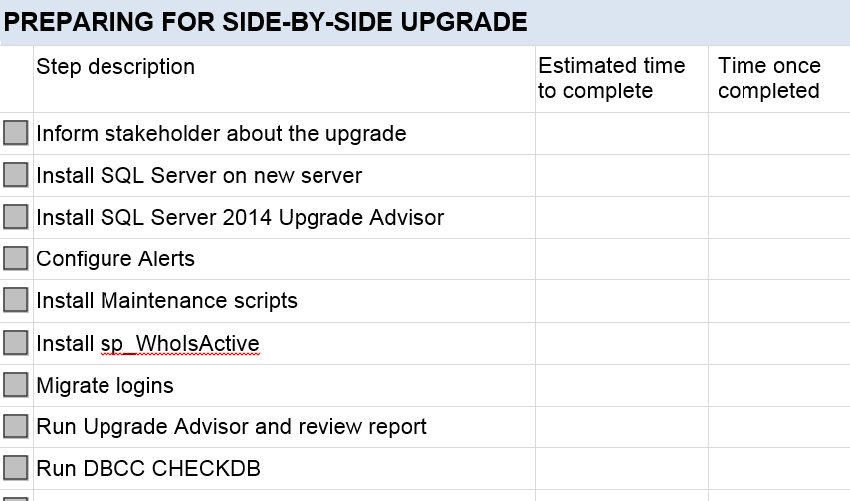
Documentation is key

Slide 51
IN Summary …
Documented approach
Review upgrade documentation and resources
Document your resources and environment
Identify upgrade requirements
Decide on upgrade strategy
Upgrade High-Availability servers
Establish backup and rollback plans
Test the plan!!!
Notes:
SQL Sever editions/features
Hardware considerations
Application compatibility

Slide 52
Resources
Key to successful upgrade is planning, prepare & testing.
Above all documentation is essential
Upgrade simulation of key databases
Post-upgrade: flex your performance tuning skills
Resources
Guide:
SQL Server 2012 Upgrade Technical reference
SQL Server 2014 Upgrade Technical reference
Books: Microsoft SQL Server 2008 R2 Administration cookbook ☺
Blogs: www.sqlserver-qa.net

Slide 53



Contact
Satya Jayanty
sqlmaster@sqlserver-qa.net
@SQLMASTER
www.sqlserver-qa.net

Slide 54
















Sponsors

